Slide 1
Other Tactics
张严辞

Slide 2
Outline
Security
Testability
Usability

Slide 3
Outline
Security
Testability
Usability

Slide 4
Security
Security is a measure of system’s ability to
protect data and information from unauthorized access
while still providing access to people and system that are authorized
Attack is an action taken against a computer system with intention of doing following harm
An unauthorized attempt to access data or cervices
An unauthorized attempt to modify data
Intended to deny services to legitimate users
…

Slide 5
Characteristics of Security
Security has six characteristics:
Confidentiality: data or services are protected from unauthorized access
Integrity: data or services are not subject to unauthorized manipulation
Availability: system will be available for legitimate use
Authentication: verifies the identities of the parties to a transaction
Nonrepudiation: guarantees that the sender of a message cannot later deny having sent the message, and that the recipient cannot deny having received
Authorization: grants a user the privileges to perform a task

Slide 6

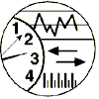
General Scenario
Artifact:
Data
Services
Stimulus:
Response：
Break CIA
Protect CIA
Record Attack
Notify Entities
Response measure：
Source:
Environment:
Human
System
Online or Offline
Behind Firewall
Operational Range
How difficult do the attack break the CIA

Slide 7
General Scenario
Source of stimulus
May be either a human or another system
A human attacker may be from outside or inside of organization
Stimuli
The stimulus is an attack
Examples: An unauthorized attempt to display data, change or delete data, access system services, change system’s behavior, or reduce availability

Slide 8
General Scenario
Artifact
Can be either services of system, data within it, or data produced or consumed by system
Response
Data or services are protected from unauthorized access
Parties to a transaction cannot repudiate
…
Response measure
How many attacks were resisted
How long does it take to recover from a successful attack
…

Slide 9
Concrete Scenario
A disgruntled employee from a remote location attempts to modify the pay rate table during normal operations.
Artifact:
Data within the System
Stimulus:
Response：
Attempts to Modify Pay Rate Table
System maintains Audit Trail
Response measure：
Source:
Environment:
Correct Data is Restored within a Day and Source Identified
Disgruntled Employee
Normal operations

Slide 10
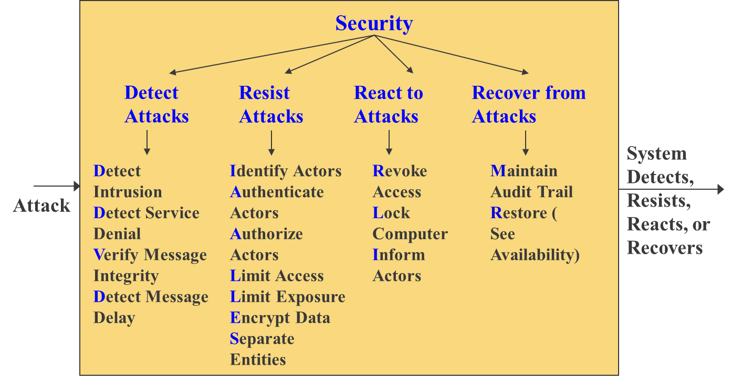
Tactics

Slide 11
Detect Attacks
Detect attacks category consists of four tactics:
Detect intrusion
Detect service denial
Verify message integrity
Detect message delay

Slide 12
Resist Attacks
There are a number of well known means of resisting an attack:
Identify actor
Authenticate actor
Authorize actor
Limit access
Limit exposure
Encrypt data
Separate entities
Change default settings

Slide 13
React to Attacks
There are three categories tactics:
Revoke access
Lock computer
Inform actors

Slide 14
Recover from Attacks
Since a successful attack can be considered a kind of failure, the set of availability tactics can be used
Additionally, keep a record of user and system actions and their effects to help identify an attacker

Slide 15
Outline
Security
Testability
Usability

Slide 16
Testability
Software testability refers to the ease with which software can be made to demonstrate its faults through testing
Objectives of software testing are opposed to that of development
Instead of making system work, it aims at breaking it, thus revealing presence of defects

Slide 17
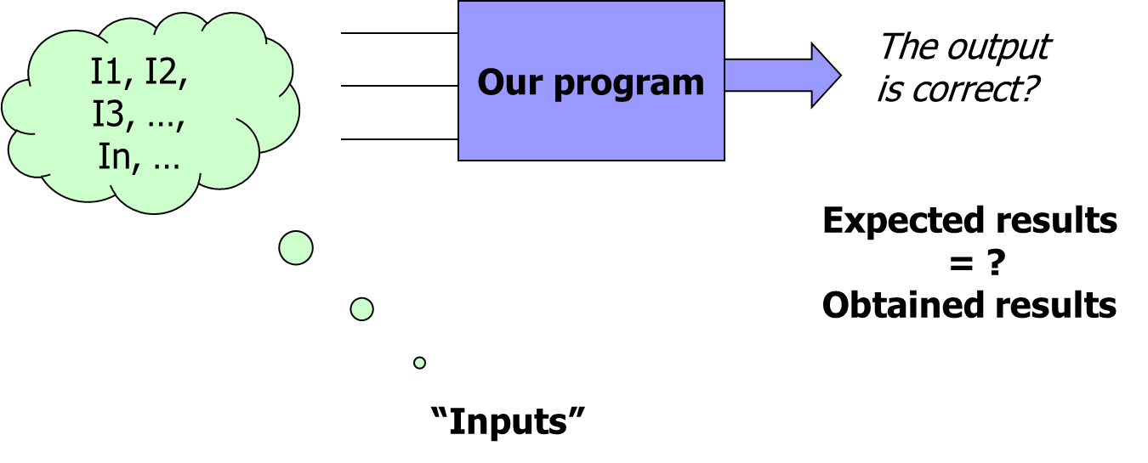
Testing
Only exhaustive testing, usually infeasible, can prove correctness

Slide 18
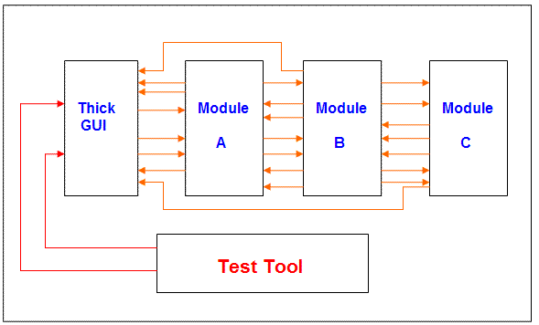
Architecture and Testability
Badly designed systems makes testing difficult
A thick GUI that has program logic
Interfaces between modules are not clearly defined
Testing of specific functions cannot be isolated
Testing has to be done through the GUI

Slide 19
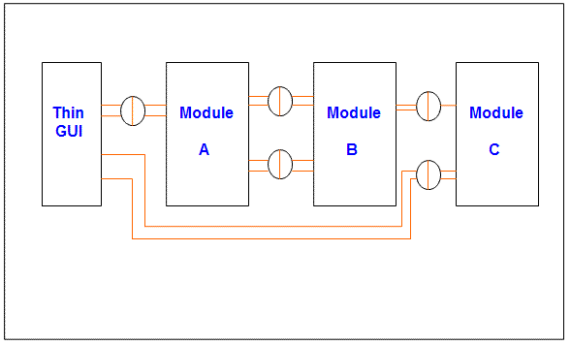
Architecture and Testability
Well architected applications makes testing simple
GUI does not contain any program logic other than dealing with presentation
Interfaces between modules are well defined

Slide 20
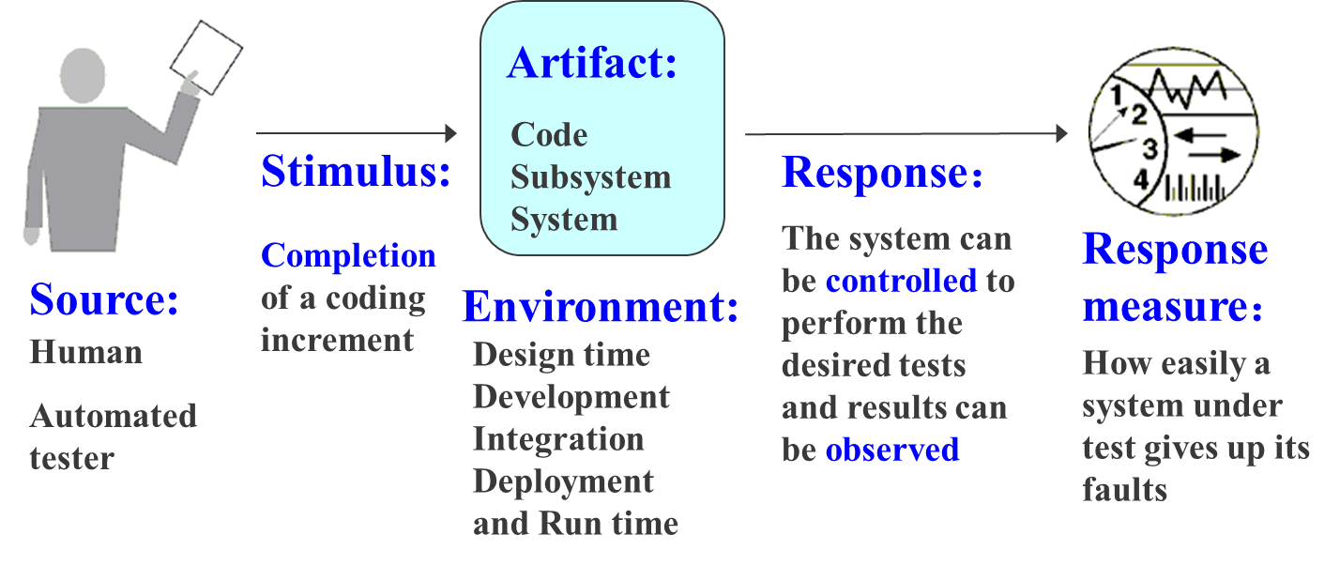
General Scenario

Slide 21
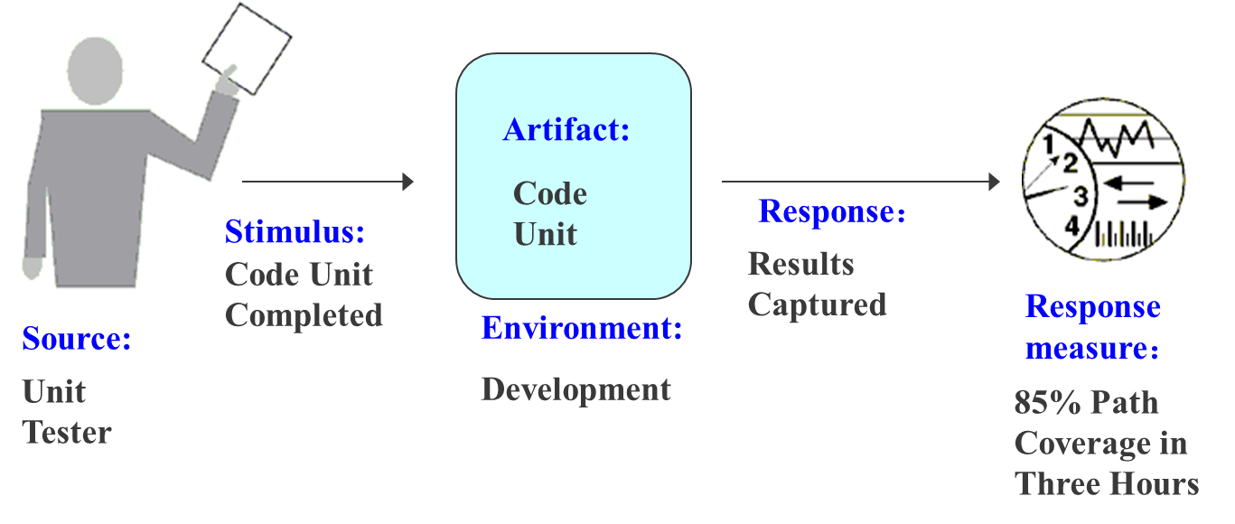
Concrete Scenario
The Unit tester completes a code unit during development and performs a test sequence whose results are captured and that gives 85% path coverage within 3 hours

Slide 22
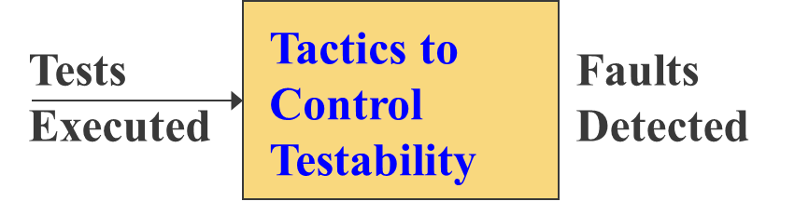
Tactics for Testability
Goal: allow for easier testing when an increment of software development is completed

Slide 23
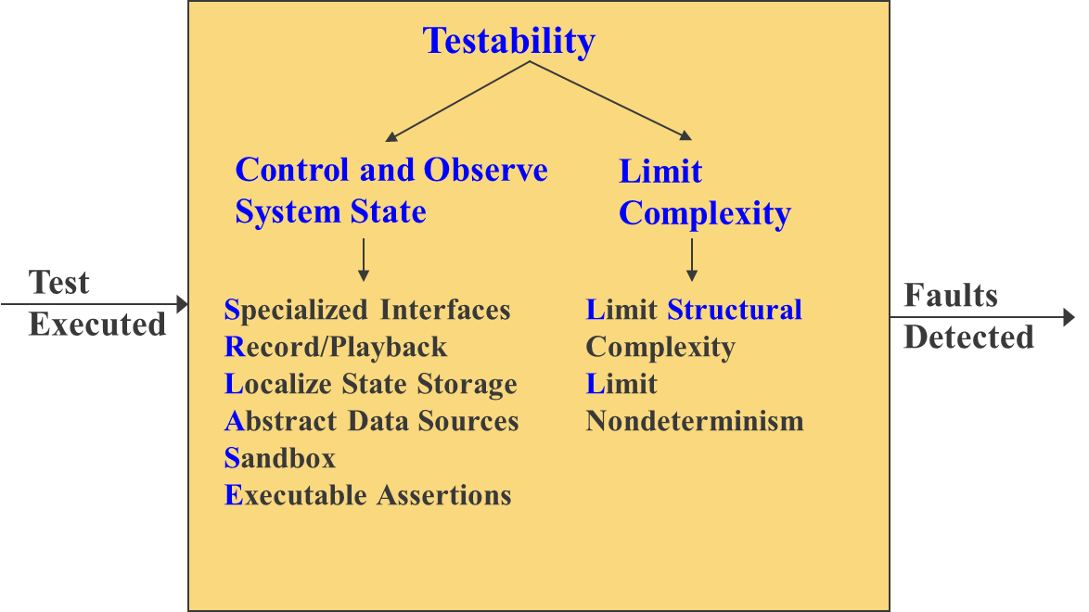
Tactics

Slide 24
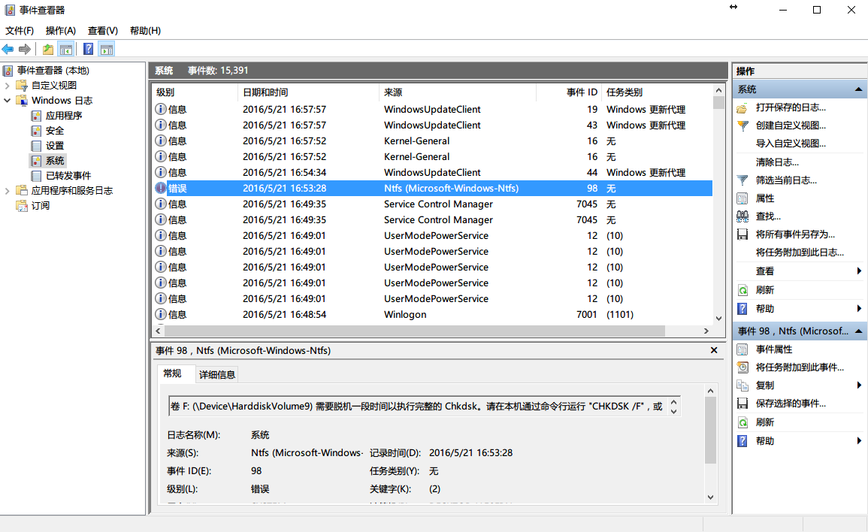
Control & Observe System State
Control and observation are central to testability

Slide 25
Control & Observe System State
Specialized interfaces
Allow to control or capture variable values for a component
A set and get method for important variables, modes, or attributes
A report method that returns full states
A reset method to set the internal state
A method to turn on output, event logging, or resource monitoring
Record & Playback
Recording state allows that state to be used to play system back and to re-create fault
Refers to both capturing information and using it as input for further testing

Slide 26
Control & Observe System State
Localize state storage
To start a system in an arbitrary state for a test, it is convenient if that state is stored in a single place
A convenient way to externalize state storage is to use a state machine as the mechanism to track an report current state
Abstract data sources
Easily controlling its input data makes it easier to test
Abstracting interfaces lets you substitute test data more easily

Slide 27
Control & Observe System State
Sandbox
Isolating an instance of system from real world to enable experimentation that is unconstrained by the worry about consequences
Executable assertions
Assertions are hand-coded and placed at desired locations to indicate when and where a program is in a faulty state
Assertions are often designed to check that data values satisfy specified constraints.
Assertions increase observability

Slide 28
Limit Complexity
Complex software is harder to test because of large state space
Large state space is more difficult to re-create
Limit structural complexity
Isolating and encapsulating dependencies on external environment
Reducing dependencies between components
Avoiding or resolving cyclic dependencies between components
Having high cohesion, loose coupling not only support modifiability, but also support testability

Slide 29
Limit Complexity
Limit nondeterminism
Nondeterminism is a very pernicious form of complex behavior
This tactic limits behavioral complexity
Example: nondeterminism in multithreaded systems that respond to unpredictable events

Slide 30
Event Logging
Good properties of event logging system
Only one instance
Support multiple output targets (std::cout, local/remote file…)
Output targets are extendable
High performance
…

Slide 31
Test Driven Development
A software development process that relies on repetition of a very short development cycle
Requirements are turned into very specific test cases
Software is improved to pass new tests
Heavily emphasized by those using Agile development methodologies

Slide 32
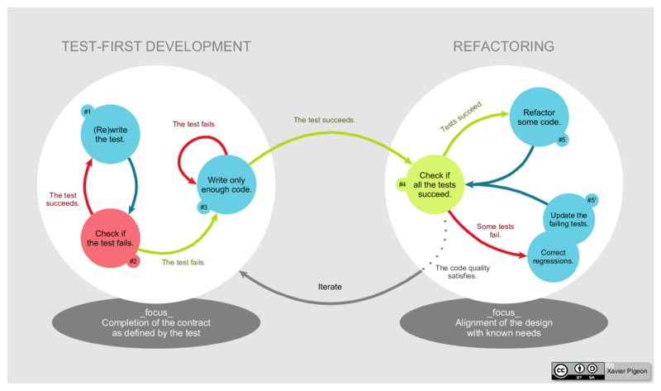
TDD Cycle

Slide 33
TDD Cycle: Add A Test
Each new feature begins with writing a test
To write a test, developer must clearly understand feature's specification and requirements
Difference from writing unit tests after coding
Make developer focus on requirements before writing code
A subtle but important difference

Slide 34
TDD Cycle: Validate New Test
Validate that the new test does not mistakenly pass without requiring any new code
Test the test itself: rules out worthless test
New test should fail for expected reason

Slide 35
TDD Cycle: Write Code
Write some code that causes test to pass
The only purpose of the written code is to pass test
Programmer must not write code that is beyond functionality that the test checks
It is acceptable that new code is not perfect and may, for example, pass test in an inelegant way

Slide 36
TDD Cycle: Run Tests
If all test cases pass, programmer can be confident that new code meets test requirements
Does not break or degrade any existing features
If any test cases fail, new code must be adjusted

Slide 37
TDD Cycle: Refactor Code
The growing code base must be cleaned up regularly
New code can be moved from where it was convenient for passing a test to where it more logically belongs
Duplication must be removed
Object, class, module, variable and method names should clearly represent their current purpose and use
Continually re-running all test cases to make sure that refactoring is not altering any existing functionality

Slide 38
TDD Cycle: Repeat
Starting with another new test, the cycle is then repeated to push forward functionality
Size of step should always be small
Reduced debugging effort: When test failures are detected, having smaller units aids in tracking down errors
Self-documenting tests: Small test cases are easier to read and to understand
If new code does not rapidly satisfy a new test, or other tests fail unexpectedly, programmer should revert in preference to excessive debugging

Slide 39
TDD Summary
Principles of TDD
KISS: keep it simple, stupid
YAGNI: You aren't gonna need it
Fake it till you make it
Benefits
Ensure that application is written for testability
Ensure that tests for every feature get written
Lead to a deeper and earlier understanding of requirements

Slide 40
Outline
Security
Testability
Usability

Slide 41
Usability
Usability is concerned with how easy it is for user to accomplish a desired task
Usability is cheapest and easiest ways to improve a system quality

Slide 42
Usability
Usability includes:
Learning system features
Using a system efficiently
Minimizing impact of errors
Adapting system to user needs
Increasing confidence and satisfaction

Slide 43
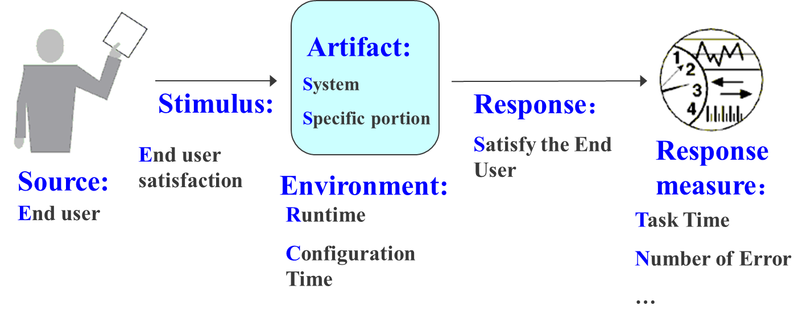
General Scenario

Slide 44
A Concrete Scenario
The user downloads a new application and is using it productively after two minutes of experimentation
Artifact:
System
Response：
Stimulus:
Downloads a New Application
User Uses Application Productively
Response measure：
Source:
Environment:
Users
Runtime
Within Two Minutes of Experimentation

Slide 45
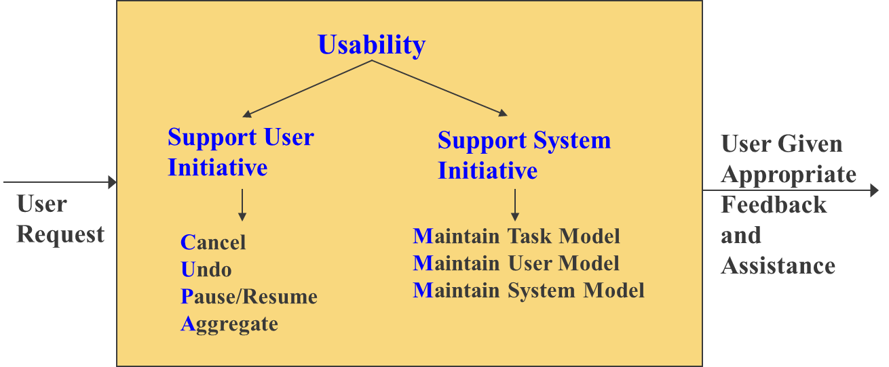
Tactics for Usability

